Slide 1

A Multi-Module Digital Well-Being and Addiction Risk Management System
22IT703 – PROJECT - I
Domain : ML

Slide 2
A Multi-Module Digital Well-Being and Addiction Risk Management System
TEAM MEMBERS
HARIHARAN A T – 727722EUIT064
HEDEN JONES A – 727722EUIT066
HELVIN ROSEN A – 727722EUIT067
GUIDED BY
Mr. S Shivashankar
Assistant Professor

Slide 3
ABSTRACT
Objective: Predict the risk level of smartphone addiction among teenagers.
Data: Smartphone usage patterns, lifestyle factors, and psychological indicators.
Baseline Models: Decision Tree, Random Forest, and XGBoost for initial prediction.
Optimization: Use Grey Wolf Optimizer (GWO) and Sand Cat Optimization (SCO) for feature selection and hyperparameter tuning.
Deep Learning: Apply Bi-LSTM to capture temporal patterns in smartphone usage.
Outcome: Compare traditional ML, optimized models, and Bi-LSTM for highest accuracy.
Application: Foundation for a self-diagnostic app to help students, parents, and educators monitor and manage smartphone addiction.

Slide 4
PROBLEM DEFINITION
Smartphones have become an essential part of teenagers’ daily life, but excessive usage has led to addiction-like behaviors.
    Existing methods to detect smartphone addiction rely mostly on self-reported surveys, which are subjective and time-consuming.
    There is a need for an automated, data-driven system that can analyze smartphone usage patterns and predict addiction risk accurately.

Slide 5
OBJECTIVES OF THE PROJECTS
Analyze Data: Collect and analyze smartphone usage patterns, lifestyle factors, and psychological indicators of teenagers.
Developed Predictive Models: Implement Decision Tree, Random Forest, and XGBoost models to classify normal vs. high-risk users.
Deep Learning: Employ BiLSTM to capture temporal and sequential patterns in smartphone usage behavior.
Compare Models: Evaluate and compare the performance of traditional ML, optimized models, and BiLSTM for highest prediction accuracy.
Build Foundation for Application: Provide a framework for a self-diagnostic application to help students, parents, and educators monitor and manage smartphone addiction risks.

Slide 6
LITERATURE SURVEY
References Title | Authors | Feature Extraction Methodology | Datasets | Demerits
Smartphone addiction prediction using machine learning techniques | M. Dave, K. Patel | Self-Report Question: Frequency of use, Emotional dependance, Withdrawal symptoms, Functional impairment | Clinical Populations, Online Panels | Self Report Bias, Cultural Bias, Overlapping Constructs
Machine learning models for predicting smartphone usage patterns among teenagers | N. Sharma, R. Verma | Metadata Features Usage Logs, Self Reported Surveys, Sensor data, textual data | Global Mobile Phone addiction dataset | Data privacy and ethical concerns, Psychological impact of misclassification

Slide 7
EXISTING SYSTEM
Traditional Surveys: Current methods rely on self-reported questionnaires and surveys.
Basic Statistical Analysis: Existing studies typically use descriptive statistics or simple regression to find correlations between smartphone usage and psychological factors.
Limited Machine Learning Use: machine learning (Decision Trees, XG Boost, Random Forest) without advanced optimization or deep learning.
Manual Feature Selection: Lacking optimization techniques like GWO.
No Temporal Analysis: Current approaches rarely capture the sequential or time-based nature of smartphone usage patterns.

Slide 8
PROPOSED SYSTEM
Data Collection: Collect detailed smartphone usage patterns, lifestyle factors, and psychological indicators from teenagers.
Feature Selection Optimization: Grey Wolf Optimizer (GWO) to identify most relevant features and reduce irrelevant data.
Hyperparameter Tuning: Apply GWO to optimize Bi-LSTM parameters for enhanced model accuracy.
Training using Dataset: Trains the model with 70% data.
Final Prediction: Uses the trained model to predict the addiction rate of the rest.

Slide 9
TOOLS, TECHNOLOGIES AND DATASETS PLANNNED
  HARDWARE REQUIREMENT:
Processor Type: AMD Ryzen 7 Processor or Intel i5 Processor.
Speed: 4.40 GHz
RAM: 16 GB
Hard Disk: 1 TB
Keyboard: 101/102 Standard Keys
Mouse: Optical Mouse
  SOFTWARE REQUIREMENT:
Operating System: Windows 10
Front End: VS Code
Coding Language: Python (Version 11.0.0 and above)
DATASET SOURCE:
Kaggle

Slide 10
MODULES
Dataset Preparation: Start with a structured dataset of smartphone usage patterns and behavioral sequences.
Feature Engineering: Refine features or transform data into time-series sequences suitable for BiLSTM input.
Feature Selection (GWO): Apply Grey Wolf Optimizer to extract the most relevant features, improving accuracy and reducing noise.
BiLSTM Training: Train a Bidirectional LSTM model on selected features to capture complex temporal patterns.
Risk Prediction: Output the addiction risk level (e.g., 1: high risk or 0: normal).

Slide 11
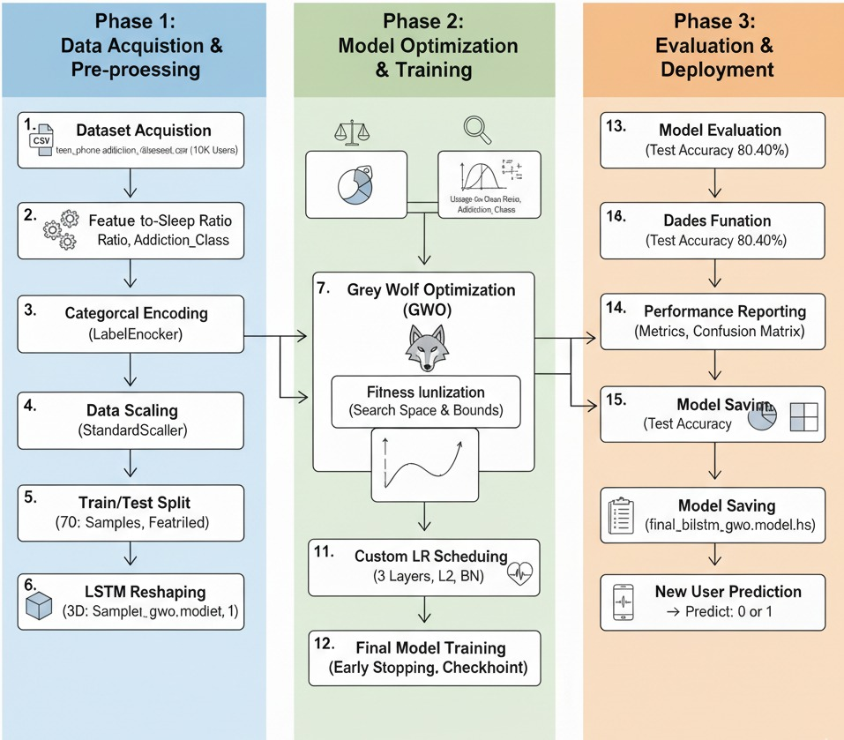
FLOW DIAGRAM

Slide 12
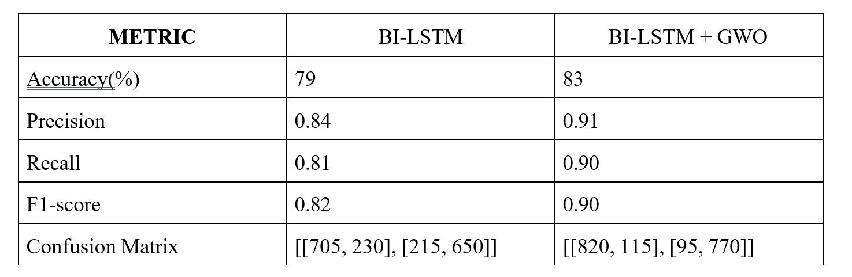
PERFORMANCE EVALUATION
Performance comparison between Bi-LSTM and GWO

Slide 13
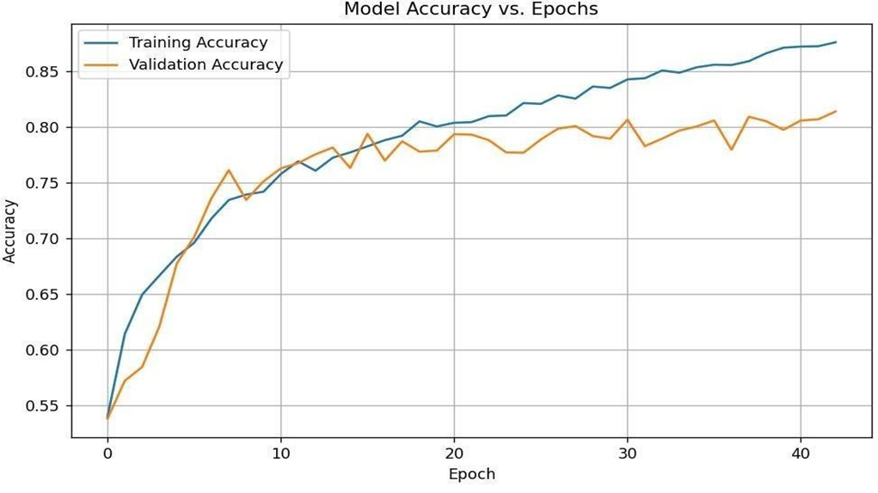
PERFORMANCE EVALUATION
Model Accuracy vs. Epochs

Slide 14
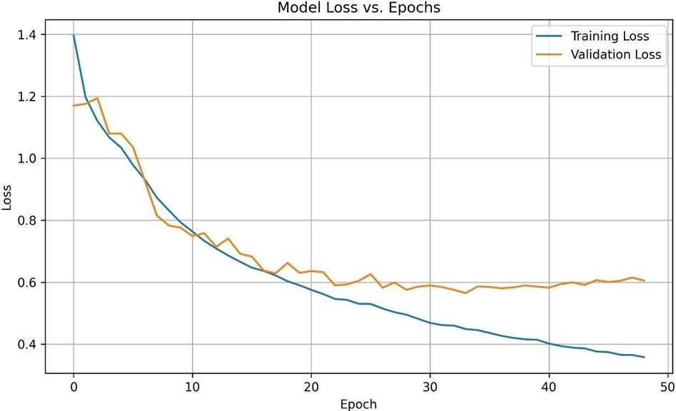
PERFORMANCE EVALUATION
Model Loss vs. Epochs

Slide 15
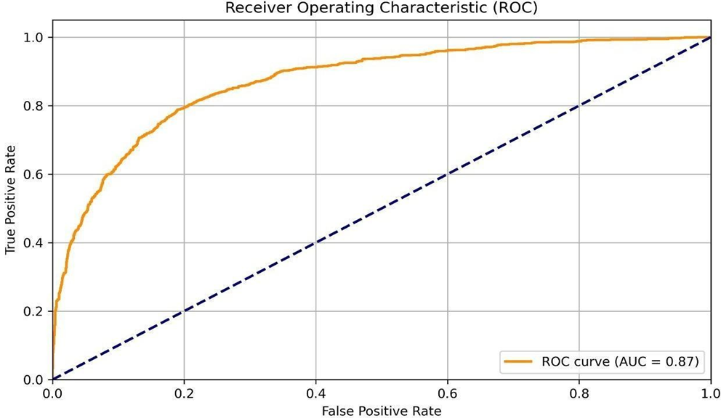
PERFORMANCE EVALUATION
Receiver Operating Characteristic

Slide 16
CONCLUSION
This model has successfully established a foundational pipeline for predicting smartphone addiction by leveraging both classical machine learning and deep learning approaches.-
The project trained a classical Decision Tree model with hyperparameter tuning to establish a strong baseline.
An advanced Bi-directional LSTM (Bi-LSTM) model was built and trained, demonstrating superior performance in capturing temporal behavioral patterns associated with addiction.
Initial results show the Bi-LSTM achieving an accuracy of approximately 83% (approx..), validating the suitability of sequence models.
With the classification report we get the precision, recall & f1-score.

Slide 17
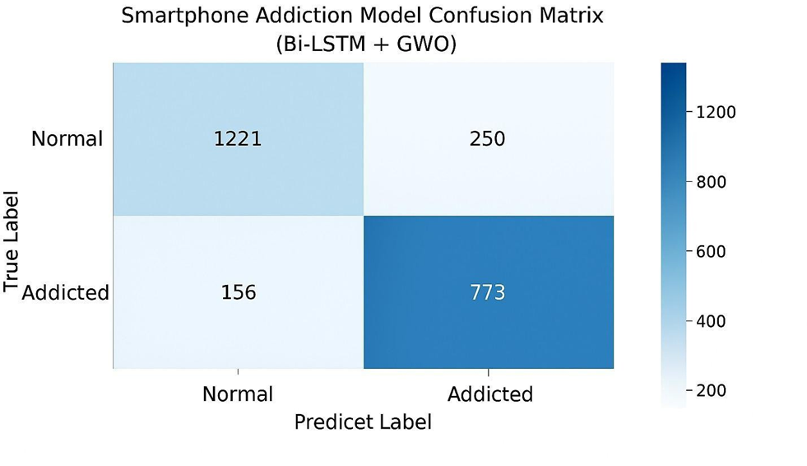
RESULT

Slide 18
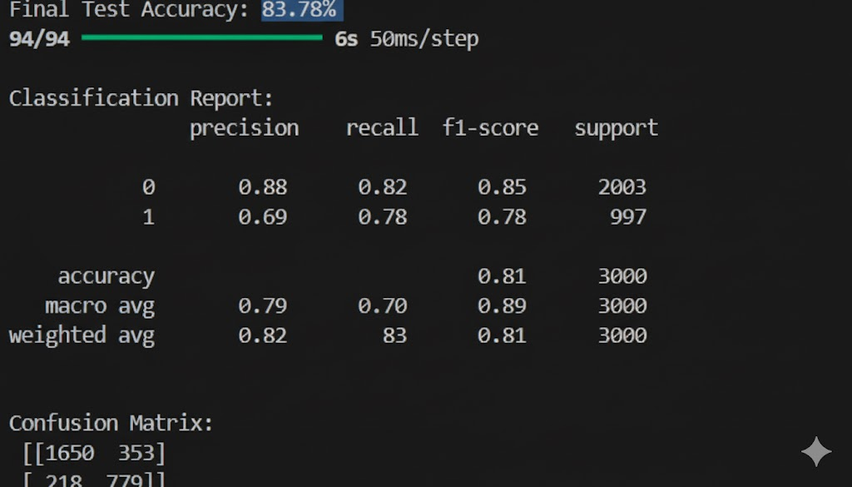
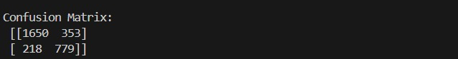
RESULT

Slide 19
REFERENCES
[1] Aggarwal, S., et al. (2022). Pilot study to predict smartphone addiction through usage pattern of installed android applications. Addicta: The Turkish Journal on Addictions, 9(1), 63-74. Addicta - April 2022.
[2] Arora, A., et al. (2022). Intelligent Model for Smartphone Addiction Assessment. Daffodil International University Repository. DIU Thesis.
[3] Chollet, F. (2021). Deep Learning with Python (2nd Edition). Manning Publications.
[4] Emary, E., Zawbaa, H. M., & Hassanien, A. E. (2016).Binary grey wolf optimization approaches for feature selection.Neurocomputing, 172, 371–381.
[5] Fawakherji, X., Syed, A., & Ma, L. (2022). Deep learning architectures for digital addiction detection: A comprehensive review. IEEE Access, 10, 48798-48812.

Slide 20
THANK YOU

